Slide 1

Evaluating State-of-the-Art Models for Unsupervised Collision Detection in Industrial Robot Time Series
MLinAPP FP01/14
s287345 Mustich Federico, s317661 Tcaciuc Claudiu Constantin, s313848 Tomatis Gabriele

Slide 2
Introduction
TAD → Time-Series Anomaly Detection
A lot of model already existing:
CNNs
RNNs
GANs
Transformers
Tree-based methods
Cluster based
etc…
Also different available approaches
Supervised
Semi-supervised
Unsupervised
Aim of the project: compare at least four SOTA models with a Bayesian one.

Slide 3
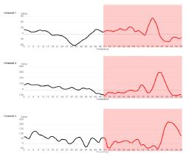
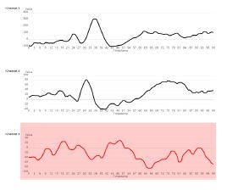

Background works
Univariate vs. Multivariate context
B. Anomaly types:
Point anomaly
b. Anomaly interval
c. Anomaly time series
C. Unsupervised TAD
Source: Gen Li et al. deep learning for anomaly detection in multivariate time series: Approaches, applications and challenges

Slide 4
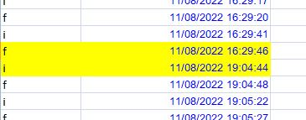
Materials & Methods - Dataset
Recorded signals from Kuka robot:
different recording frequencies
different recording sessions
ground truth & metadata information
highly imbalance dataset (Unsupervised TAD)
HUGE gap in one of the recorded session
Source: Project dataset, recorded signals from Kuka robot

Slide 5
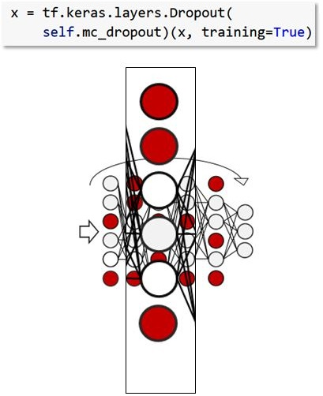
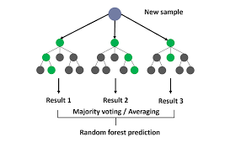
Materials & Methods - Models
Action score based models: Predicted outcome is an action of the dataset
Bayesian model
Random forest classifier
Source: Ponzio Francesco, Lab07 Laboratory Solution, Politecnico di Torino
Source: https://medium.com/@roiyeho/random-forests-98892261dc49

Slide 6
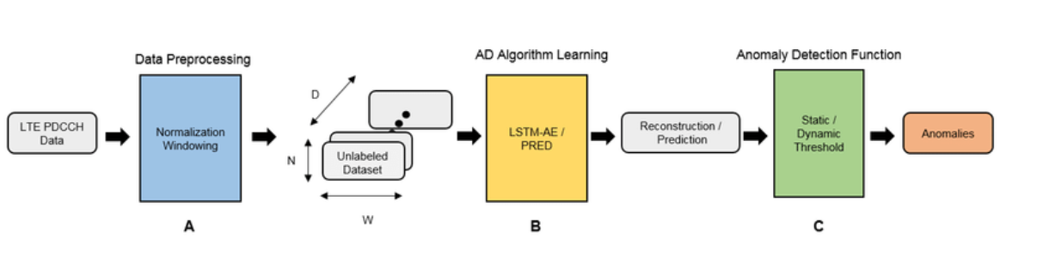
Materials & Methods - Models
Anomaly score based models: Predicted outcome is an estimate of how much the actual reading differs from the expected value.
LSTM models:
LSTM–AD
LSTM-ED
Trinh, Hoang Duy & Zeydan, Engin & Giupponi, L. & Dini, Paolo. (2019). Detecting Mobile Traffic Anomalies Through Physical Control Channel Fingerprinting: A Deep Semi-Supervised Approach. IEEE Access. PP. 1-1. 10.1109/ACCESS.2019.2947742.

Slide 7
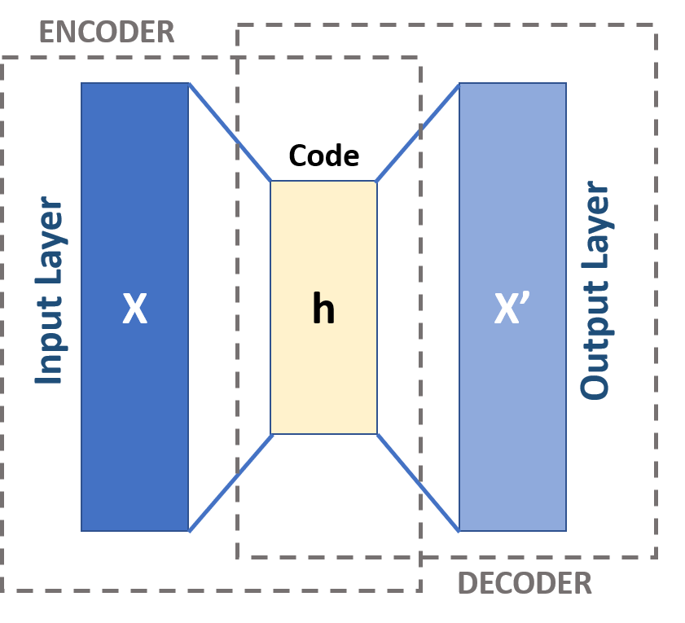
Materials & Methods - Models
Anomaly score based models: Predicted outcome is an estimate of how much the actual reading differs from the expected value.
Different deep learning models:
Autoencoder
DAGMM
RNN-EBM
By Michela Massi - Own work, CC BY-SA 4.0, https://commons.wikimedia.org/w/index.php?curid=80177333

Slide 8
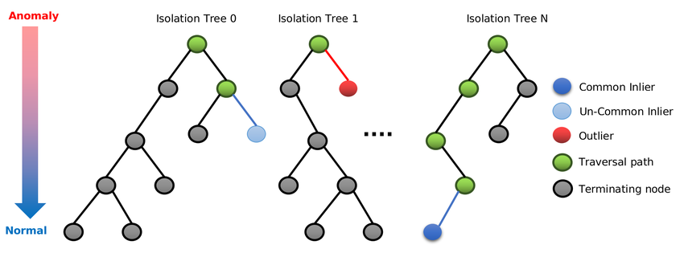
Materials & Methods - Models
Anomaly score based models: Predicted outcome is an estimate of how much the actual reading differs from the expected value.
Tree based models:
Isolation Forest
XGBoost
Dairi, Abdelkader & Harrou, Fouzi & Sun, Ying. (2022). Efficient Driver Drunk Detection by Sensors: A Manifold Learning-Based Anomaly Detector. IEEE Access. PP. 1-1. 10.1109/ACCESS.2022.3221145.

Slide 9
Materials & Methods - Thresholds
The predictions were made by comparing
the anomaly scores with respect to five different thresholds:
STD: μ + 2σ
MAD: median + 2 * median(|X - median|)
Percentile: 95th percentile
IQR: Q3 + 1.5 * (Q3 - Q1)
Zero: Used only for Isolation Forest

Slide 10
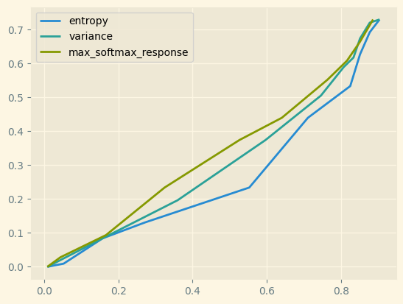
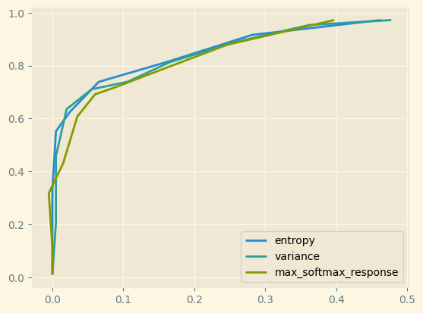
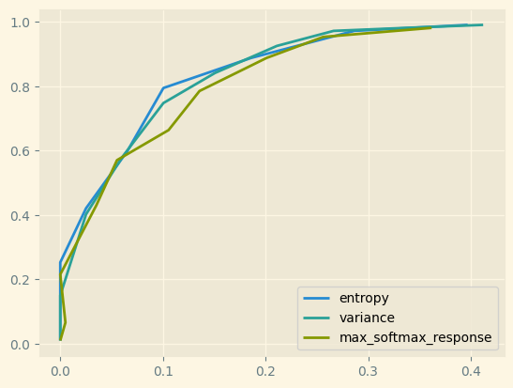
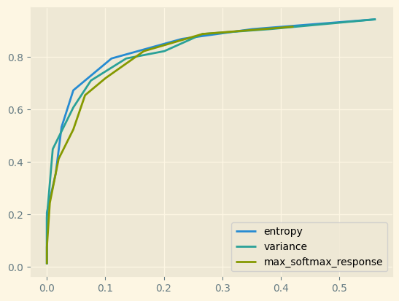
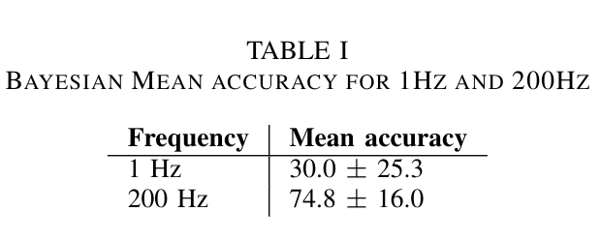
Results - Action Based Models
ROC plot results for Bayesian MLP model on different sampling frequencies (1, 10, 100, 200 Hz).

Slide 11
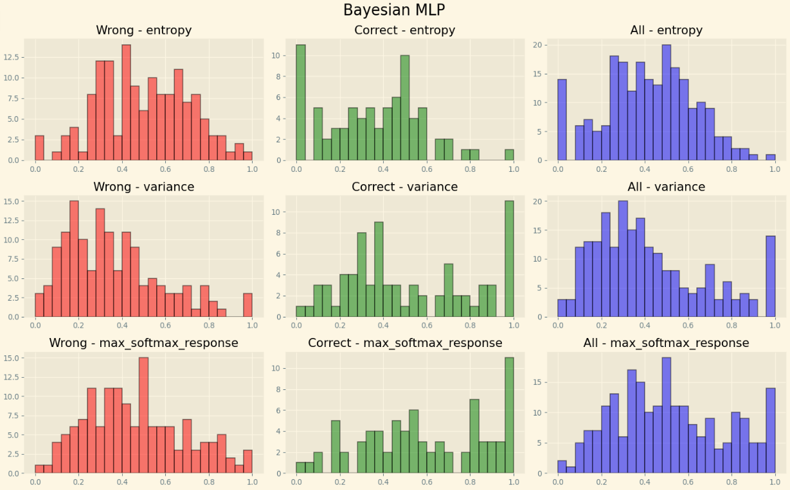
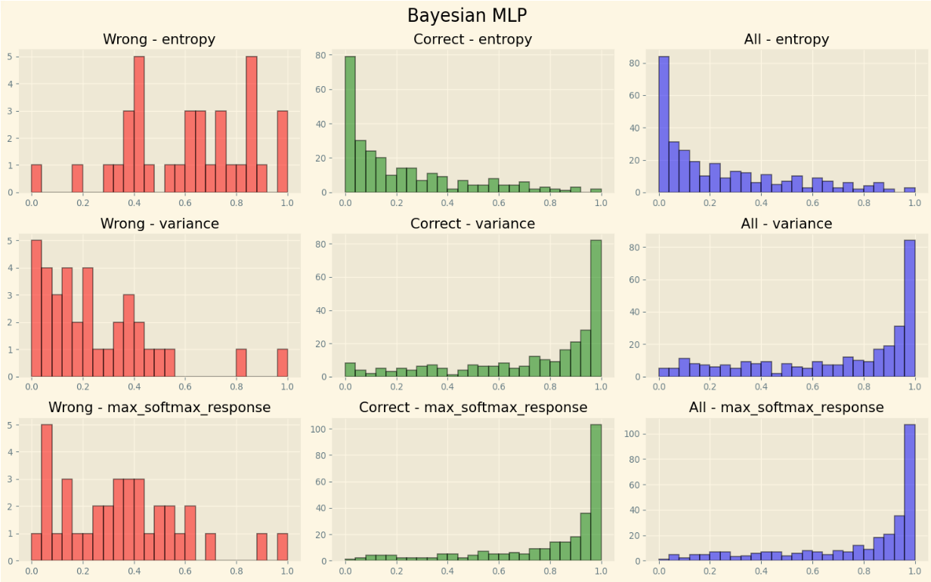
Results - Action Based Models
Bayesian uncertainty matrix at 1Hz on the conjunction dataset
Bayesian uncertainty matrix at 200Hz on the conjunction dataset

Slide 12
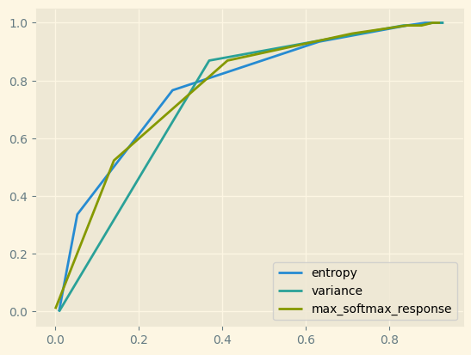
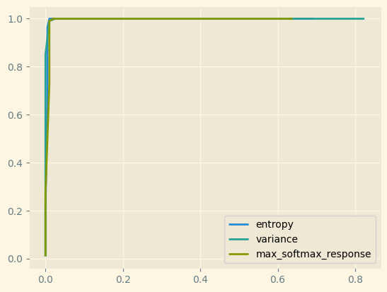
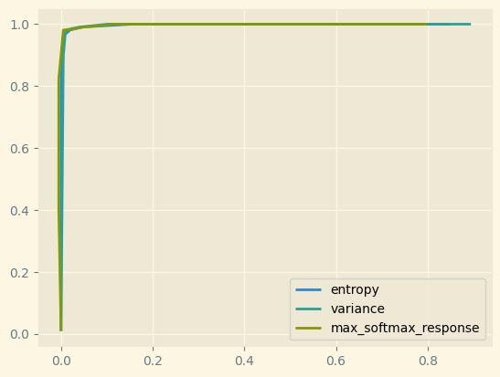
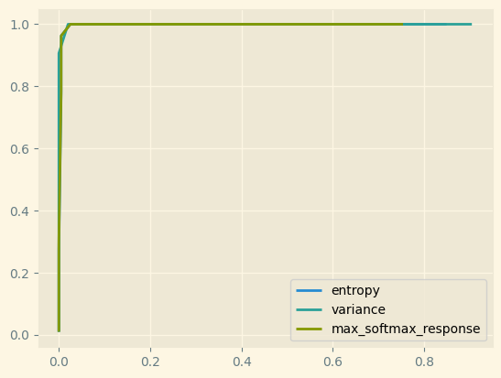
Results - Action Based Models
ROC plot results for Random Forest on different sampling frequencies (1, 10, 100, 200 Hz).
Due to the dataset being unbalanced, ROC curves may return an over-optimistic result.

Slide 13
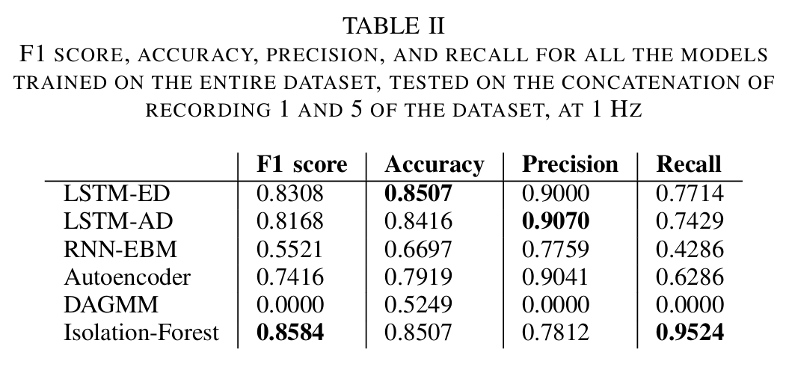
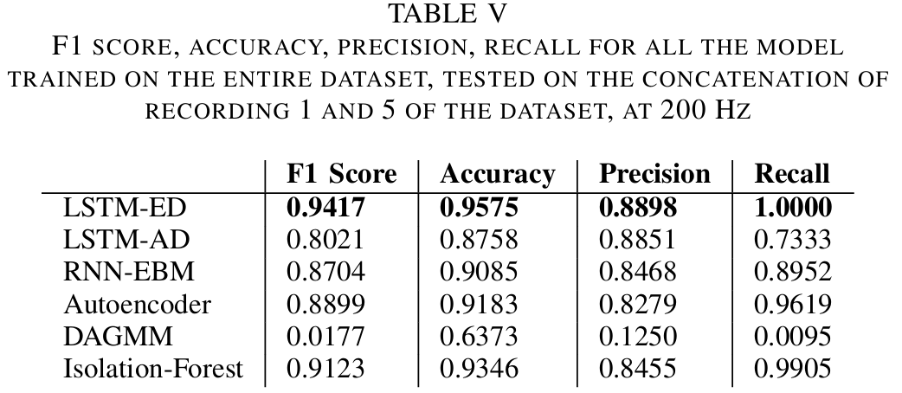
Results - Anomaly Score Based Models
This analysis helps in identifying the most robust models suitable for varying frequencies, enhancing the reliability of anomaly detection in dynamic environments.

Slide 14
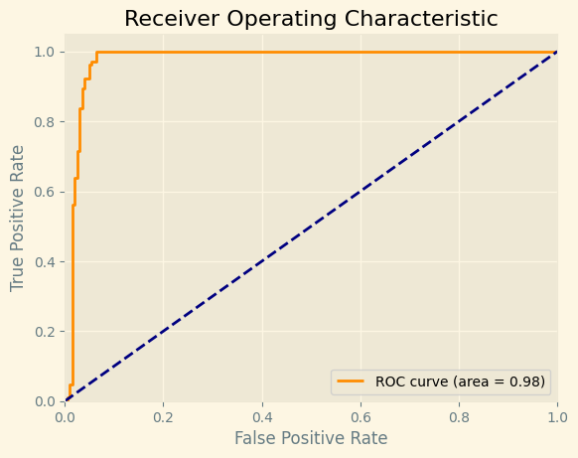
Results - LSTMED
The ROC curve highlights the LSTM-ED model's robust ability to detect anomalies, achieving an exceptional AUC of 0.98
fig: LSTM-ED ROC curve at 200Hz on the conjunction dataset

Slide 15
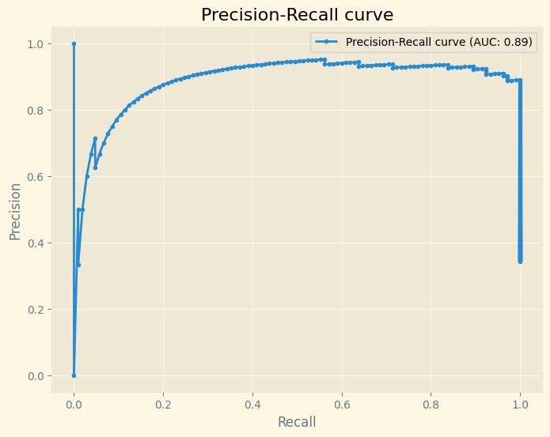
Results - LSTMED
The Precision-Recall curve for the LSTM-ED model underlines its strong performance in anomaly detection, boasting an AUC of 0.89.
fig: LSTM-ED PRC curve at 200Hz on the conjunction dataset

Slide 16
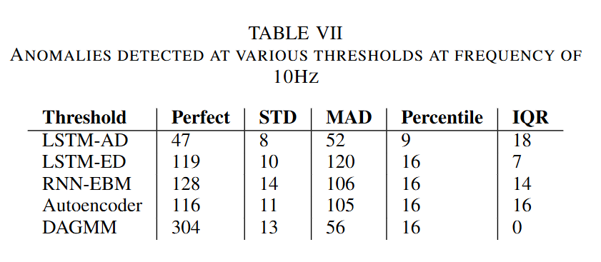
Results - Threshold selection
number of TRUE collisions: 105
The comparison reveals how each thresholding method impacts the detection capabilities of the models, with a reference to the actual number of true collisions, which stands at 105.

Slide 17
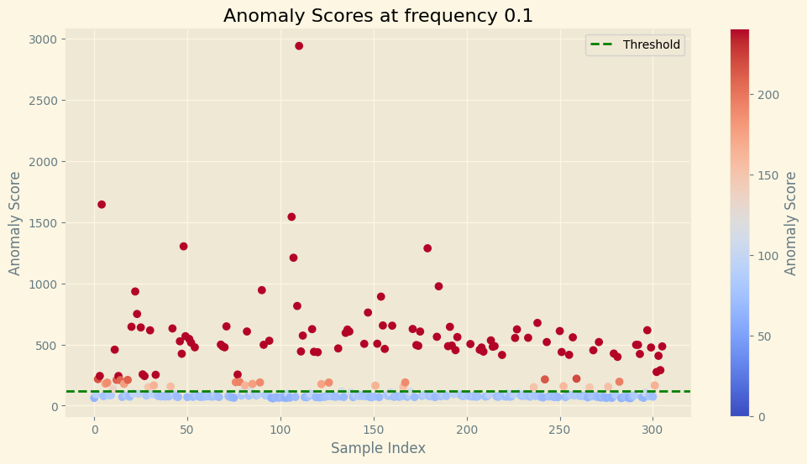
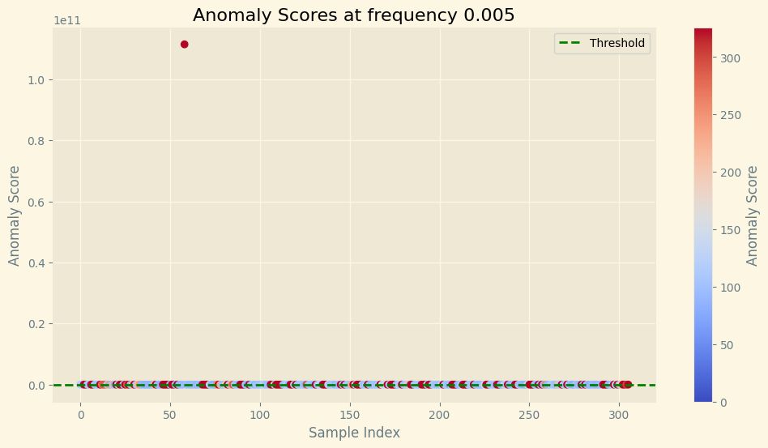
Results - Threshold selection
LSTM-ED anomalies detected with MAD threshold at 10Hz
LSTM-ED anomalies detected with MAD threshold at 200Hz
These plots demonstrate the robustness of the MAD threshold in identifying anomalies across varying data sampling rates, effectively capturing discrepancies at both high and low frequencies.

Slide 18
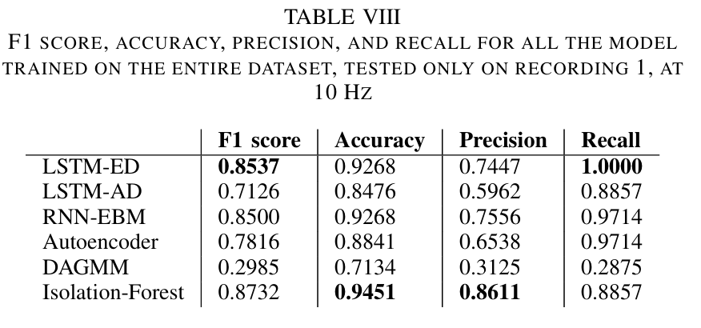
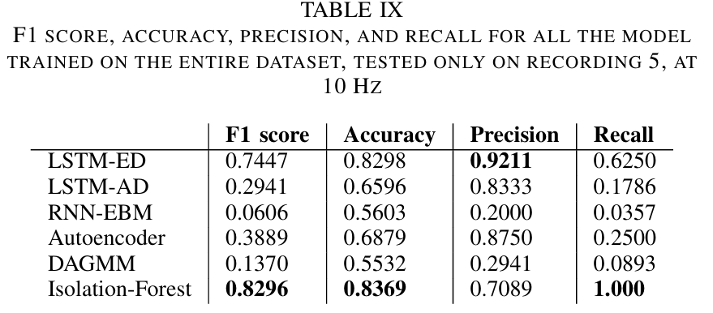
Results - splitted recordings
This segmentation helps identify which models are more versatile and effective across diverse scenarios without the averaging effect of combined data analysis.

Slide 19
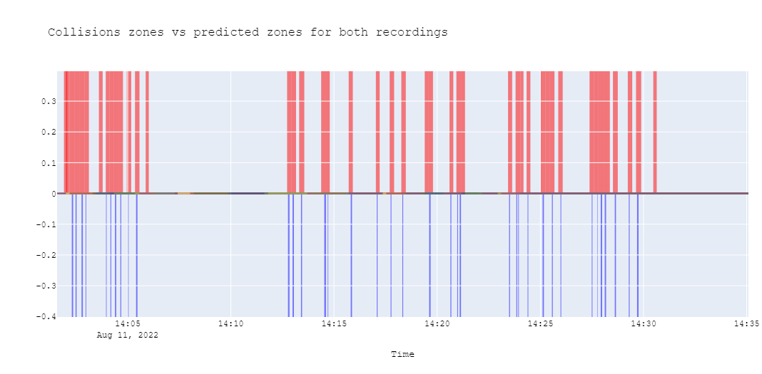
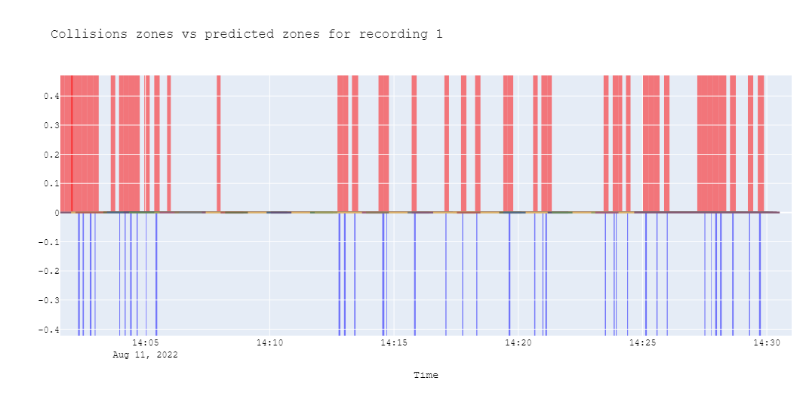
Results - splitted recordings
LSTM-ED anomalies over time, in red are the predicted ones, in blue the true anomalies registered in the collision file for the period 14:00-14:30 for recording 1 and 5
LSTM-ED anomalies over time, in red are the predicted ones, in blue the true anomalies registered in the collision file for the period 14:00-14:30 for recording 1

Slide 20
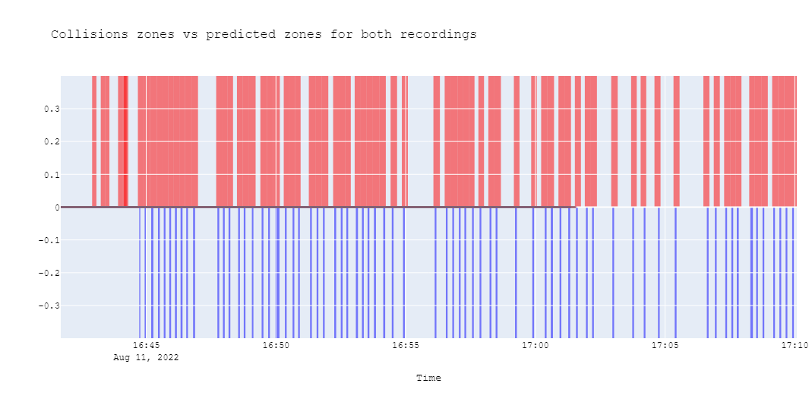
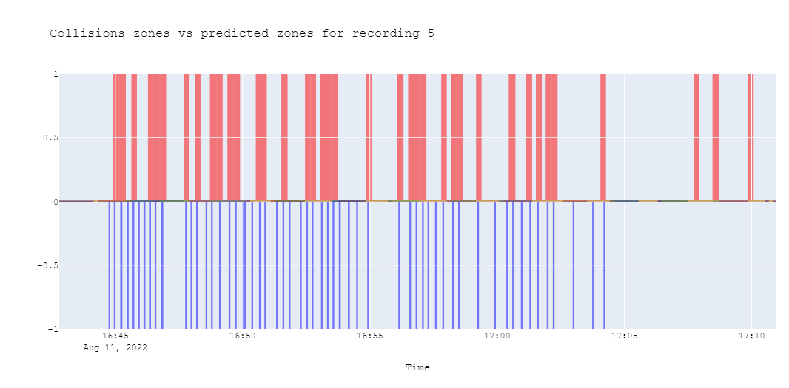
Results - splitted recordings
LSTM-ED anomalies over time, in red are the predicted ones, in blue the true anomalies registered in the collision file for the period 16:40-17:10 for recording 1 and 5
LSTM-ED anomalies over time, in red are the predicted ones, in blue the true anomalies registered in the collision file for the period 16:40-17:10 for recording 5

Slide 21
Conclusions & Future Works
We evaluated seven models against a custom MLP Bayesian model across frequencies from 1Hz to 200Hz.
LSTM-ED proved most effective, showing robust anomaly detection across all tested frequencies.
The Bayesian Model reveals itself to perform averagely for this task, especially at low frequency.
We suggest exploring feature reduction techniques and expanding dataset diversity to enhance model reliability and applicability to industrial robotics.

Slide 22
Thanks for your attentions

